Slide 1

TDE(Transparent Data Encryption)

Slide 2
Agenda
What is TDE - How it works?
Flow Chart
Best Practices
Pros - Cons
Licensing
Notes:
+ Securities Process suite – that has all the application with SFP but also valdi OMS, protegent, XSP - ecosystem.
Data Process management - Astec Analytics
Global One for Out of the Box for APAC – targeted for small brokers
Securities Finance Transaction Regulation Reporting (SFTR)
Securities finance managed services
Collateral – extended functionality thro’ integration with Adadptiv on SIMM
Collateral - Collateral management for Banking book with Profile 8
WSC – grow with Trust Clients

Slide 3
What is TDE – How it works?
Transparent Data Encryption (TDE) was introduced in SQL Server 2008. It’s main purpose was to protect data by encrypting the physical files, both the data (mdf) and log (ldf) files (as opposed to the actual data stored within the database). Transparent Data Encryption Encrypts SQL Server, Azure SQL Databases, and Azure SQL Data Warehouse data files.
Using TDE, we can encrypt database backup’s as well.
With TDE, The data transmitted over the network is not encrypted and the data at the object level remains unencrypted. In other words, if a user has select access to a table(s) within the TDE enabled database, he/she will be able to read data with simple select statements, as the name suggests, it’s transparent.
TDE is implemented at the database level and is an all or nothing solution – so all data within the database will be encrypted – you can’t just encrypt the sensitive columns.

Slide 4
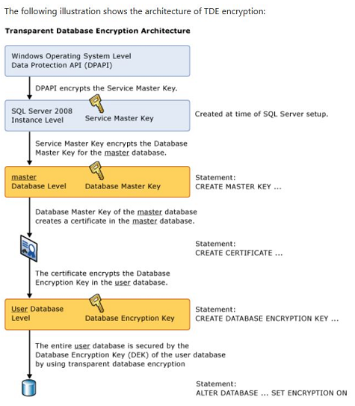
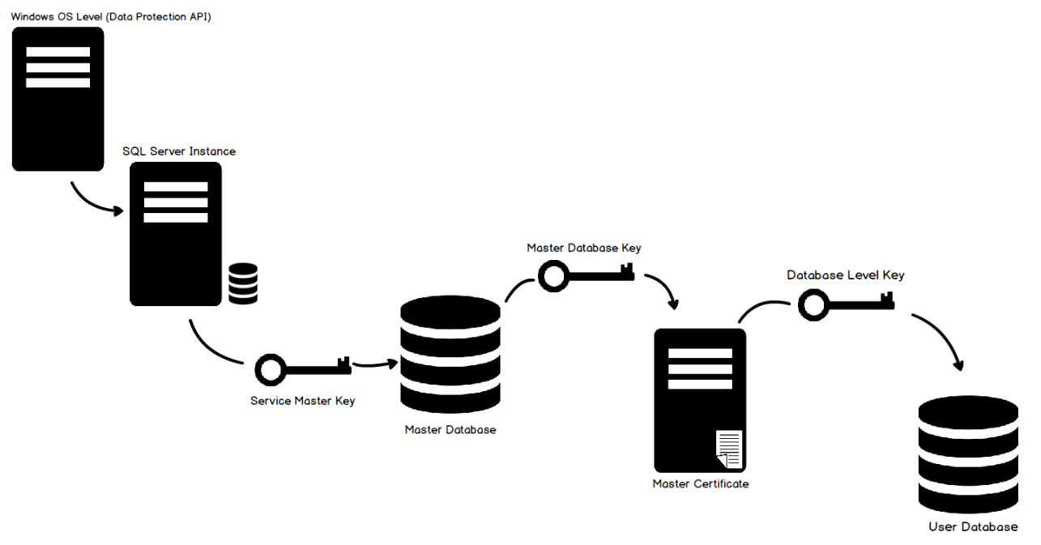
Flow Chart

Slide 5
Best Practices
Take a backup before encryption database to avoid any issues.
Need to keep an eye on Transaction Log during the Encryption process as it may grow larger than normal.
Make sure Encryption Keys are stored safely, as these will be needed to remove encryption. If disaster occurs and you need to restore the database to another server from a backup file then the backup will be useless without the certificate and private key.
The password for the private key does not have to be the same as the database master key password.
Need to look I/O and CPU before implementing it as SQL Server instances with low I/O and low CPU usage will have the least performance impact. Servers with high CPU usage will have the most performance impact.

Slide 6
Pros - Cons
PROS:
It doesn't require a re-architecture of the application to call the encryption and decryption functions.
If performance is a concern or you would like to avoid manually implementing encryption (normally a time-consuming process) then TDE is the way to go.
Works with high availability features, such as mirroring, AlwaysOn and log shipping.
Works with older versions of SQL Server, back to 2008.
Fairly simple to Implement.
CONS:
1. Only encrypts data at rest, so data in motion or held within an application is not encrypted.
2. All data in the database is encrypted – not just the sensitive data.
3. Requires the expensive Enterprise Edition (or Developer or DataCenter Edition) of SQL Server.
4. As TempDB is encrypted, there is potentially an impact on non-encrypted databases on the same server.
5. There is a small performance impact. Microsoft claims this is only 2 – 4% compared to a non-encrypted database.

Slide 7
Licensing
TDE can be used on below versions
Sr No. | Versions
1 | SQL 2016 Evaluation, Developer, Enterprise
2 | SQL 2014 Evaluation, Developer, Enterprise
3 | SQL Server 2012 Evaluation, Developer, Enterprise
4 | SQL Server 2008 R2 Datacenter, Evaluation, Developer, Enterprise, Datacenter
5 | SQL Server 2008 Evaluation, Developer, Enterprise

Slide 8
Thanks
Jiten Pansara

